Slide 1
Detail ProJet Report (DPR)
Healthcare Data Analysis
Author: Dibyendu Biswas
Version: 1.0

Slide 2
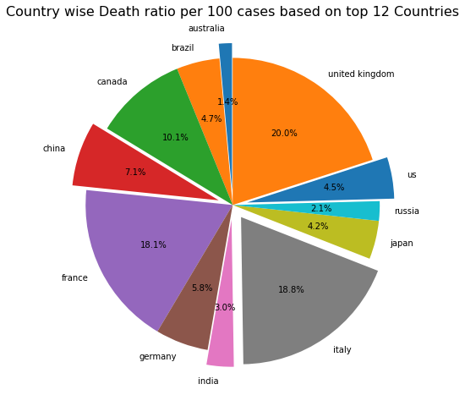
INTRODUCTION
During the COVID-19 pandemic has put some health systems under immense pressure and stretched others beyond their capacity. As such, responding to this public health emergency and successfully minimizing its impact requires every health resource to be leveraged. Failure to protect health care in this rapidly changing context exposes health systems to critical gaps in services when they are most needed, and can have a long-lasting impact on the health and wellbeing of populations.
However, attacks on health care not only have a direct impact on the ability of health systems to deliver services to those most in need, but also take a heavy toll on the psychosocial health of patients, critical health care providers on the frontline and their families. As those continue to be targeted by acts of violence during this public health emergency, health systems must – among other things – prepare for shortages of health care workers unwilling or unable to report to work due to unsafe environments or obstruction in their personal lives.
In this scenario Data Analysis can help us to understand the how many people are dead; how many people are recovered and how many people are affected and the gap or the failure of the health care system and also helps to improve the better health care system worldwide.

Slide 3
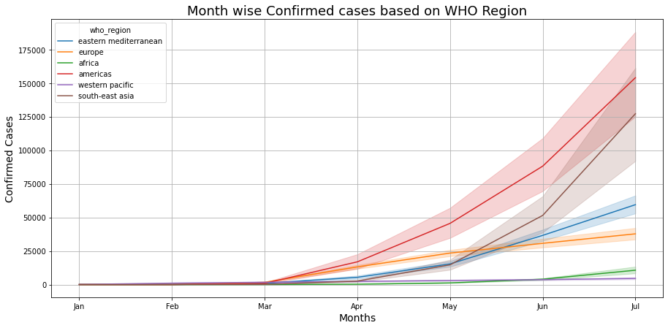
Analysis based on WHO Region (Confirmed Cases)
There are 6 WHO Region:
Eastern Mediterranean Region
Europe Region
Africa region
Americas region
Western Pacific Region
South East Asia Region
Confirm Cases Region wise (highest to low)
American Region
South East Asia Region
Eastern Mediterranean Region
Europe Region
Africa region
Western Pacific Region
(showing the graph: fig:0.2)

Slide 4
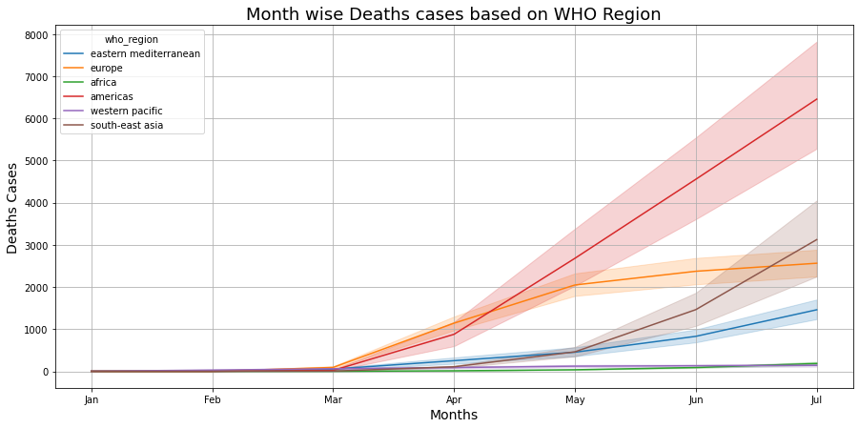
Analysis based on WHO Region (Death Cases)
There are 6 WHO Region:
Eastern Mediterranean Region
Europe Region
Africa region
Americas region
Western Pacific Region
South East Asia Region
Death Cases Region wise (highest to low)
American Region
Europe Region
South East Asia Region
Eastern Mediterranean Region
Africa region
Western Pacific Region
(showing the graph: fig:0.3)

Slide 5
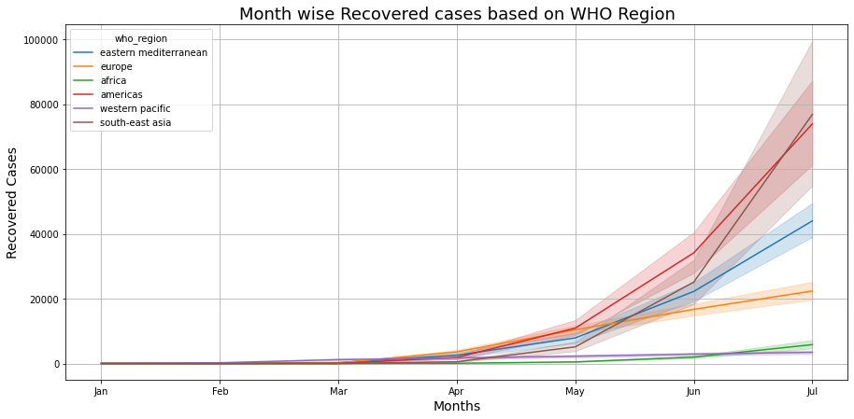
Analysis based on WHO Region (Recovered Cases)
There are 6 WHO Region:
Eastern Mediterranean Region
Europe Region
Africa region
Americas region
Western Pacific Region
South East Asia Region
Recovered Cases Region wise (highest to low)
American Region
South East Asia Region
Eastern Mediterranean Region
Europe Region
Africa region
Western Pacific Region
(showing the graph: fig:0.4)

Slide 6
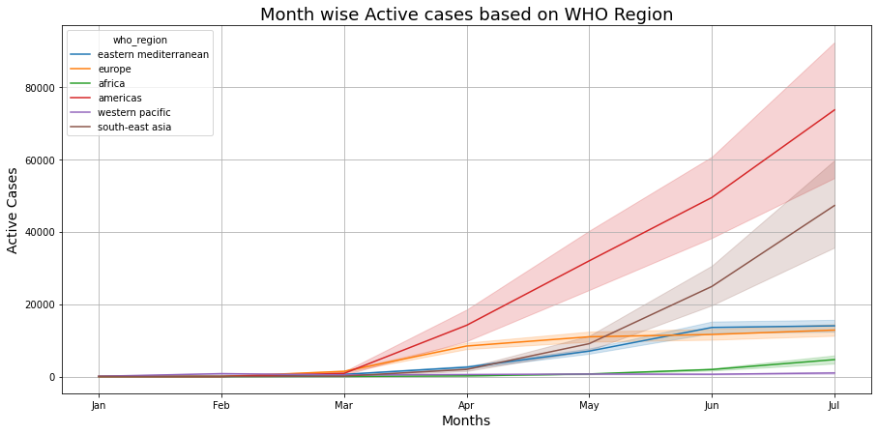
Analysis based on WHO Region (Active Cases)
There are 6 WHO Region:
Eastern Mediterranean Region
Europe Region
Africa region
Americas region
Western Pacific Region
South East Asia Region
Recovered Cases Region wise (highest to low)
American Region
South East Asia Region
Eastern Mediterranean Region
Europe Region
Africa region
Western Pacific Region
(showing the graph: fig:0.5)

Slide 7
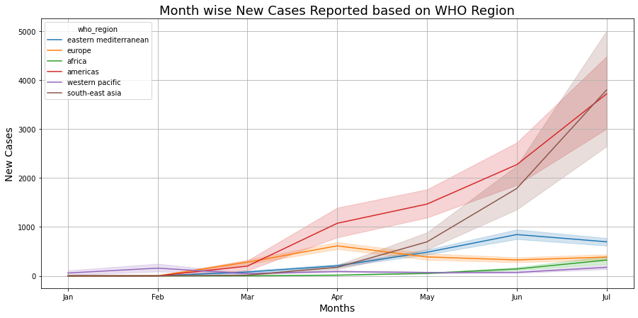
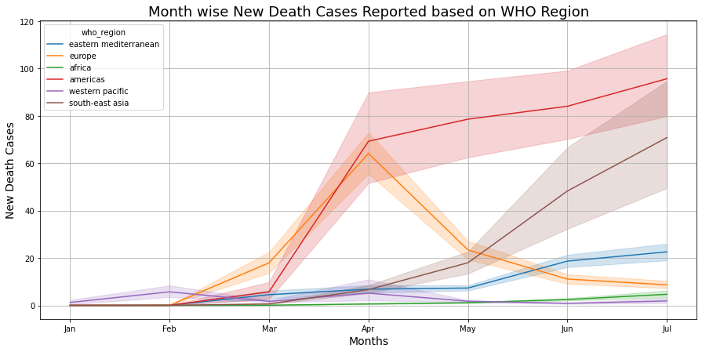
Analysis based on WHO Region (New Cases & New Deaths)

Slide 8
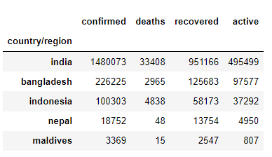
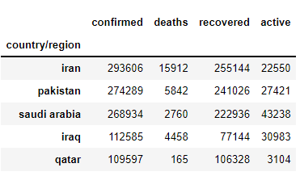
Analysis based on WHO Regions
South East Asian Region
Here we get the data (confirmed, death, recovered, active cases)
Eastern Mediterranean Region
Here we get the data (confirmed, death, recovered, active cases)

Slide 9
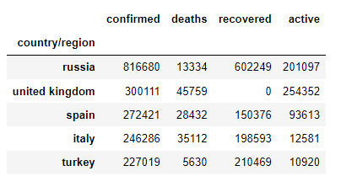
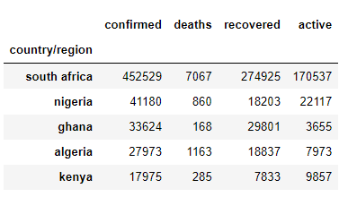
Analysis based on WHO Regions
Europe Region
Here we get the data (confirmed, death, recovered, active cases)
Africa region
Here we get the data (confirmed, death, recovered, active cases)

Slide 10
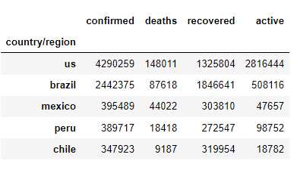
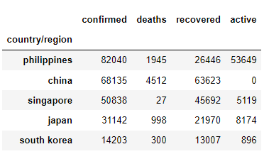
Analysis based on WHO Regions
Americas region
Here we get the data (confirmed, death, recovered, active cases)
Western Pacific Region
Here we get the data (confirmed, death, recovered, active cases)

Slide 11
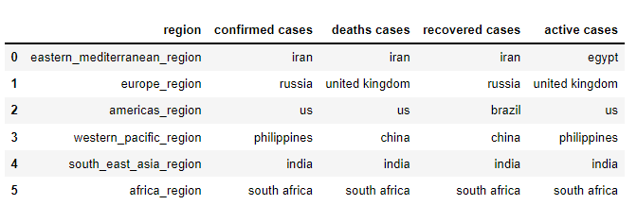
Analysis based on WHO Regions (Get the highest data)

Slide 12
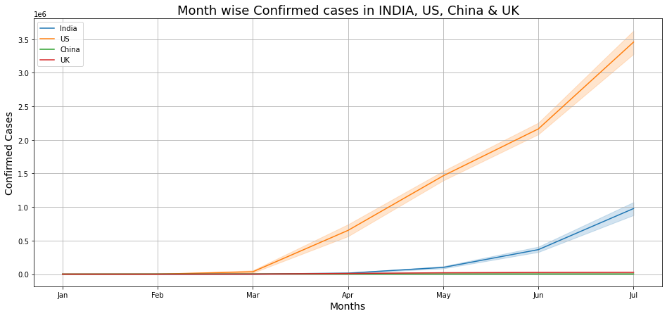
Analysis based on India, China, US & UK

Slide 13
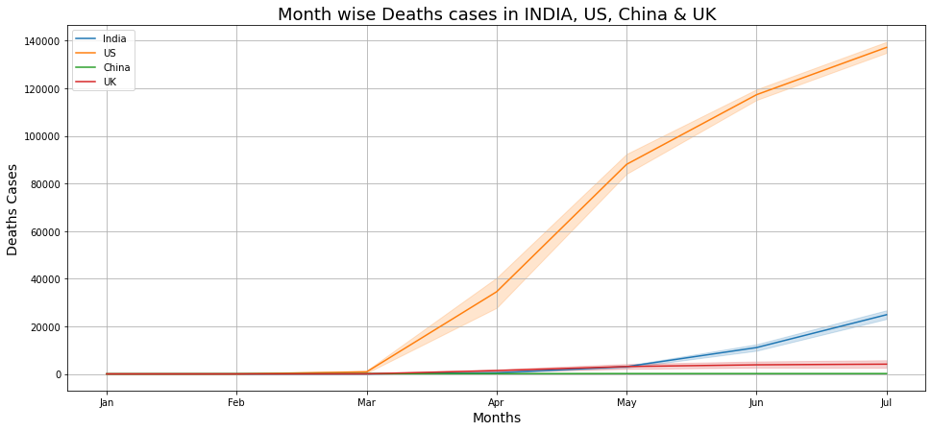
Analysis based on India, China, US & UK

Slide 14
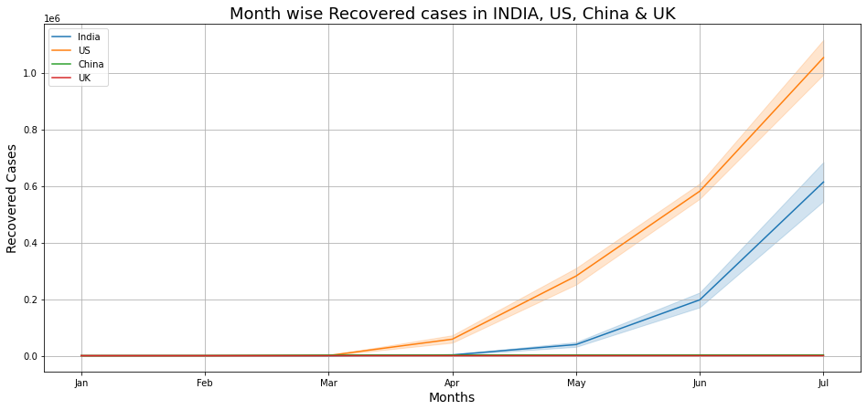
Analysis based on India, China, US & UK

Slide 15
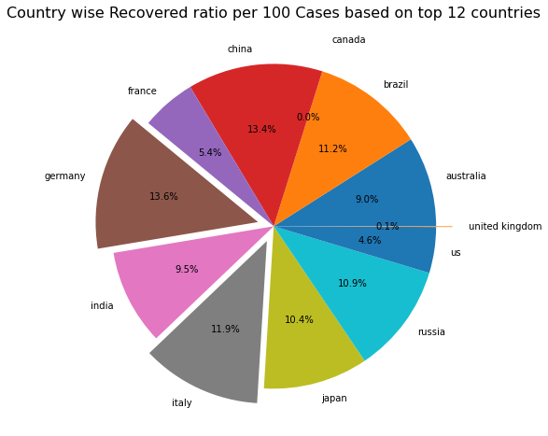
Analysis based on top 12 Countries
Countries:
India, China, US, UK, France, Germany, Italy, Canada, Russia, Japan, Australia, Brazil

Slide 16
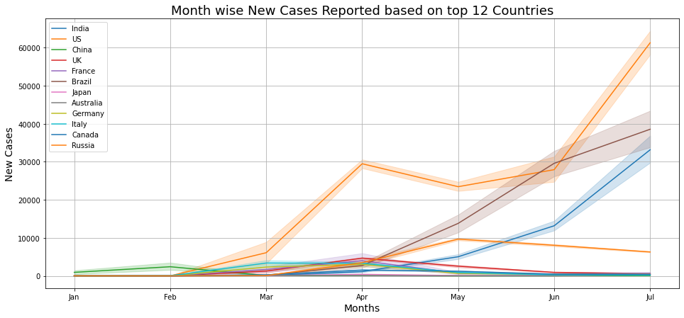
Analysis based on top 12 Countries
Countries:
India, China, US, UK, France, Germany, Italy, Canada, Russia, Japan, Australia, Brazil

Slide 17
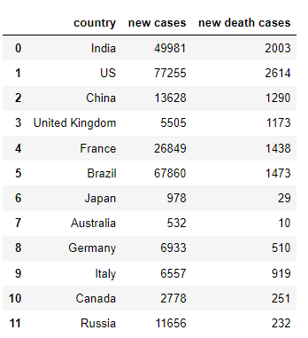
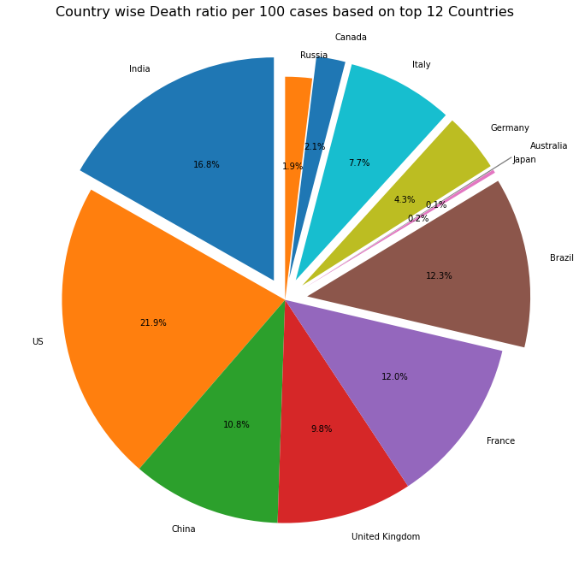
Analysis based on top 12 Countries
Countries:
India, China, US, UK, France, Germany, Italy, Canada, Russia, Japan, Australia, Brazil

Slide 18
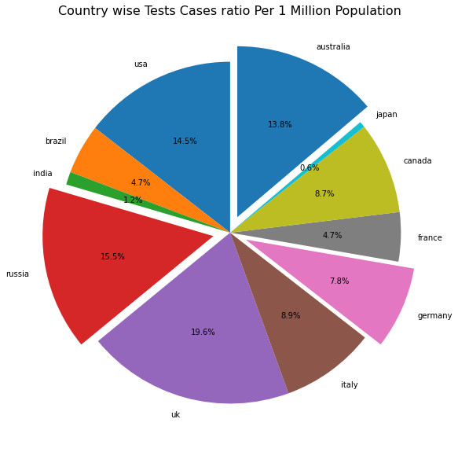
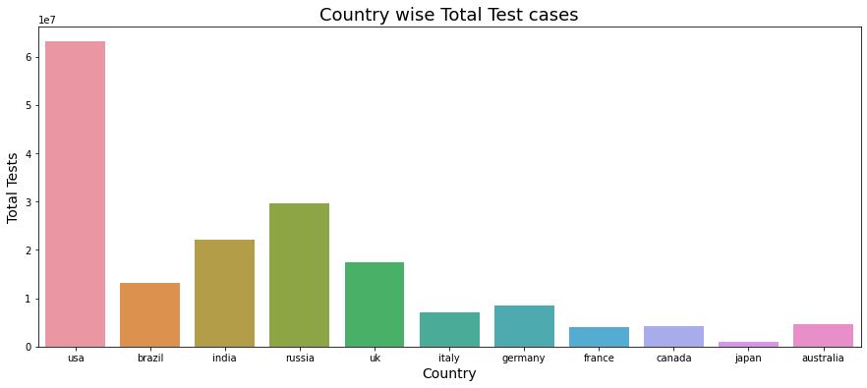
Analysis based on top 12 Countries
Countries:
India, China, US, UK, France, Germany, Italy, Canada, Russia, Japan, Australia, Brazil

Slide 19
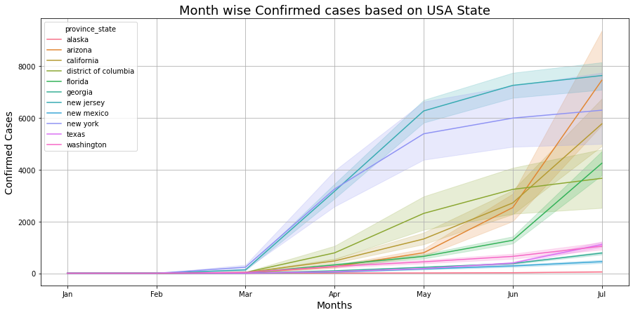
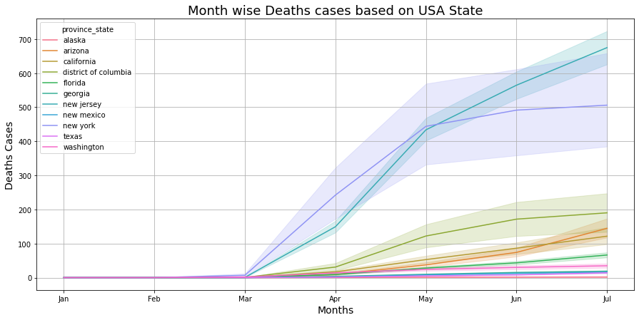
Analysis based on USA
States:
Alaska, Arizona, California, District of Columbia, Florida, Georgia, New Jersey, New Mexico, New York, Texas, Washington

Slide 20
------------------------ Thank You ----------------------

